Slide 1
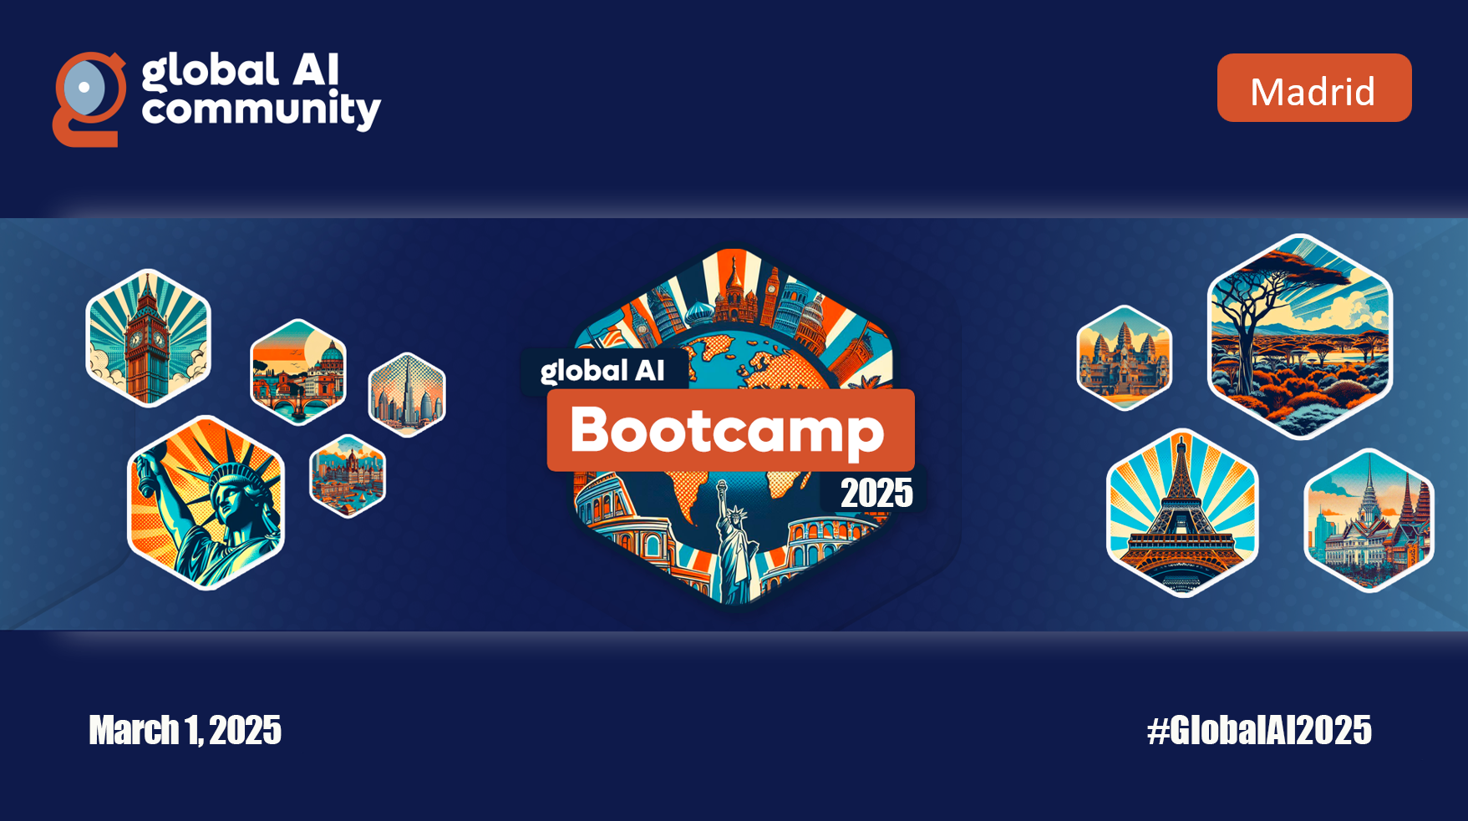

Slide 2


Semantic Kernel: Revoluciona tus aplicaciones empresariales con IA nativa
Emiliano Montesdeoca
Cloud Dev Team Lead @ Intelequia
@emimontesdeocaa
linkedin.com/in/emimontesdeoca

Slide 3










Gracias a nuestros patrocinadores

Slide 4
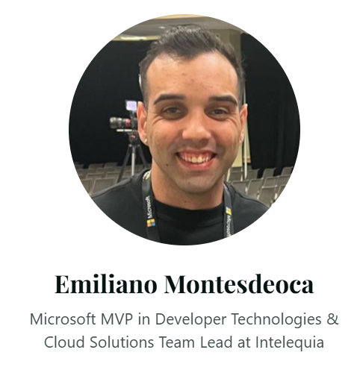
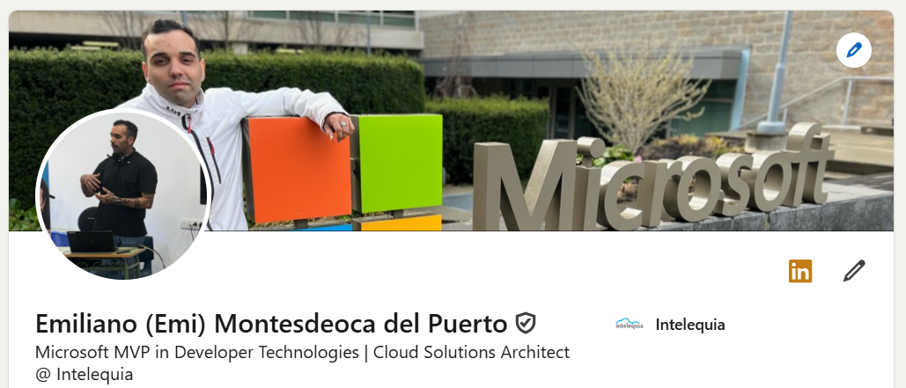


Me pueden llamar Emi
Cloud Dev Team Lead
Microsoft MVP ~2022
Uruguayo + Español
@emimontesdeocaa + #GlobalAIEmiliano
Notes:
Artificial intelligence (AI) has a long and storied history that spans many decades.
Some of the earliest work in AI was done in the 1950s and 1960s,
Mimic human / "think" like humans.
During the 1950s and 1960s, AI research focused primarily on "symbolic" AI, which involved creating symbolic representations of knowledge and using them to solve problems.

Slide 5

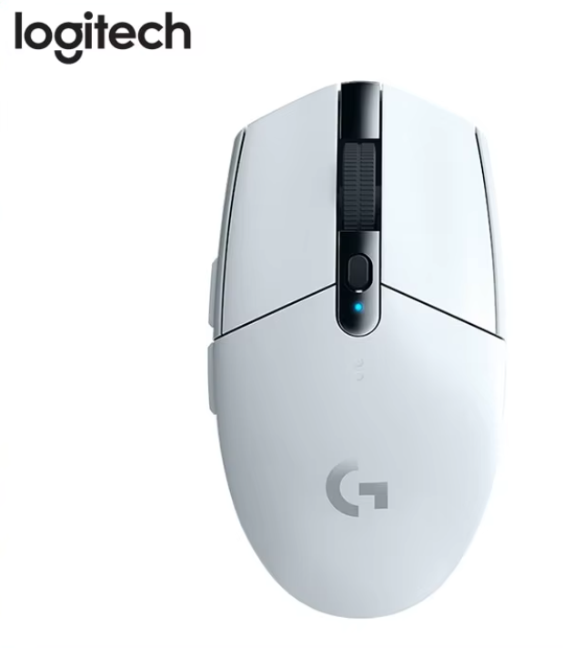
¡Hay sorteo (solo aqui)!
Follow @emimontesdocaa + #GlobalAIEmiliano
Notes:
Do I need Fine-tuning? Mostly the answer is no.
You might want to use fine tuning for modifying the tone and format of the AI output, not for adding knowledge.
Fine-tuning requires additional compute to adjust the model's weights.
Fine-tuning employs Low-rank Adaptation to integrate the new weights with the base model.

Slide 6
¿Como le meto IA a mi app?
Tu jefe probablemente cada semana
@emimontesdeocaa + #GlobalAIEmiliano
Notes:
Do I need Fine-tuning? Mostly the answer is no.
You might want to use fine tuning for modifying the tone and format of the AI output, not for adding knowledge.
Fine-tuning requires additional compute to adjust the model's weights.
Fine-tuning employs Low-rank Adaptation to integrate the new weights with the base model.

Slide 7
¿Que es lo que tenemos?
Aplicaciones hoy en dia
Interacciones roboticas
El codigo es fijo
No hay “inteligencia”
Hacer un cambio es complejo
Y cuesta dinero tambien
@emimontesdeocaa + #GlobalAIEmiliano
Notes:
In the 1990s and 2000s, AI research continued to evolve, and new subfields began to emerge. With more data available with the introduction of the internet and the desktop computer
One of these was "machine learning," which focuses on creating algorithms that allow computers to learn from data without being explicitly programmed.

Slide 8
¿Que es lo que queremos?
Aplicaciones inteligentes
Interacción en lenguaje natural
Experiencias personalizadas basadas en datos
Que aprenda y mejore continuamente
@emimontesdeocaa + #GlobalAIEmiliano
Notes:
In the 1990s and 2000s, AI research continued to evolve, and new subfields began to emerge. With more data available with the introduction of the internet and the desktop computer
One of these was "machine learning," which focuses on creating algorithms that allow computers to learn from data without being explicitly programmed.

Slide 9
Mi pizzeria vs Mi pizzerIA
Mi pizzeria actual
Mi pizzerIA
Tengo que mirar a ver que pizzas hay entre muchas
No puedo filtrar por las pizzas que me gustan
Voy a hacere el pedido y me olvido de pedir
Tengo que volver a empezar
Le pregunto si tiene pizzas disponbiles
Le digo que me quite las pizzas si tiene piña
Le puedo decir que me añada las ultimas dos otra vez, que se me olvidaron
Le digo que me quite una pizza que no me da el dinero
@emimontesdeocaa + #GlobalAIEmiliano
Notes:
In the 1990s and 2000s, AI research continued to evolve, and new subfields began to emerge. With more data available with the introduction of the internet and the desktop computer
One of these was "machine learning," which focuses on creating algorithms that allow computers to learn from data without being explicitly programmed.

Slide 10
¿Como convierto mi aplicacion tonta en inteligente?
¡¡A eso viniste boludo!!
@emimontesdeocaa + #GlobalAIEmiliano
Notes:
Do I need Fine-tuning? Mostly the answer is no.
You might want to use fine tuning for modifying the tone and format of the AI output, not for adding knowledge.
Fine-tuning requires additional compute to adjust the model's weights.
Fine-tuning employs Low-rank Adaptation to integrate the new weights with the base model.

Slide 11

Semantic Kernel
AI made easy!
@emimontesdeocaa + #GlobalAIEmiliano

Slide 12
Semantic kernel es un kit de desarrollo ligero y de código abierto que le permite crear fácilmente agentes de inteligencia artificial e integrar los modelos de IA más recientes.
@emimontesdeocaa + #GlobalAIEmiliano
Notes:
Prompt engineering is a concept in Natural Language Processing (NLP) that involves embedding descriptions of tasks in input to prompt the model to output the desired results.
Prompt typically includes problem descriptions, instructions on how to solve the problem, and examples of correct problem and solution pairs.

Slide 13
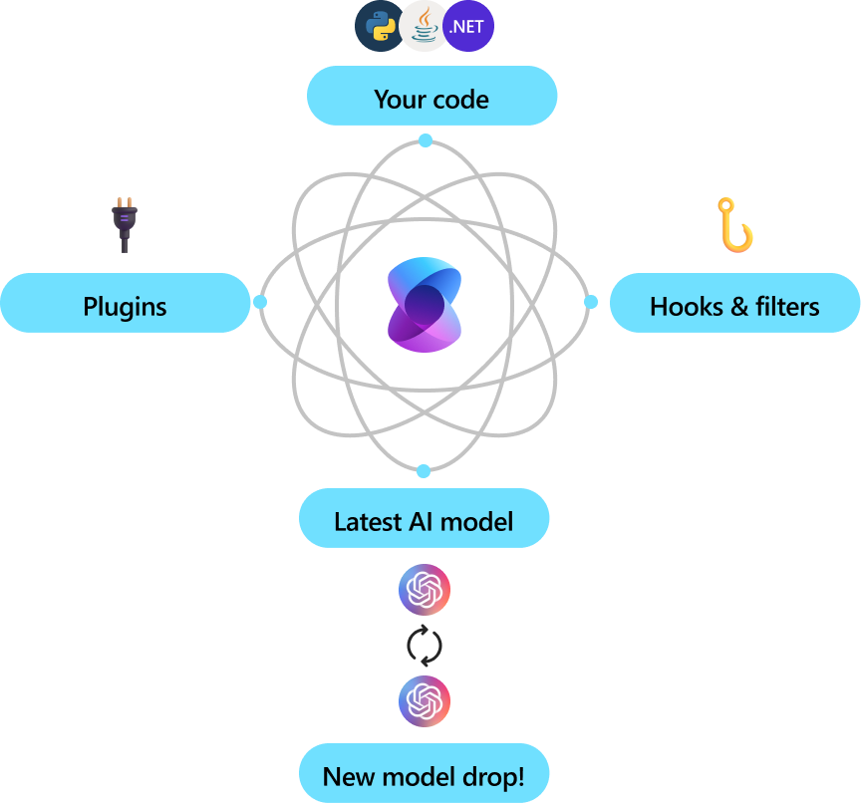
Sirve como un middleware eficaz que permite la entrega rápida de soluciones de nivel empresarial.
@emimontesdeocaa + #GlobalAIEmiliano
Notes:
Prompt engineering is a concept in Natural Language Processing (NLP) that involves embedding descriptions of tasks in input to prompt the model to output the desired results.
Prompt typically includes problem descriptions, instructions on how to solve the problem, and examples of correct problem and solution pairs.

Slide 14
Conceptos basicos
🔌
📖
✏️
Plugins
Planners
Personas
Usa tus APIs que ya tienes desarrolladas para que la IA obtenga datos y complete tareas
Usa los plugins con el modelo para crear una secuencia de tareas
Con los plugins y los planners, puedes crear agentes para tu negocio
@emimontesdeocaa + #GlobalAIEmiliano
Notes:
Prompt engineering is a concept in Natural Language Processing (NLP) that involves embedding descriptions of tasks in input to prompt the model to output the desired results.
Prompt typically includes problem descriptions, instructions on how to solve the problem, and examples of correct problem and solution pairs.

Slide 15
¿Y si programamos algo major?
No se olviden del sorteo :)
@emimontesdeocaa + #GlobalAIEmiliano
Notes:
Do I need Fine-tuning? Mostly the answer is no.
You might want to use fine tuning for modifying the tone and format of the AI output, not for adding knowledge.
Fine-tuning requires additional compute to adjust the model's weights.
Fine-tuning employs Low-rank Adaptation to integrate the new weights with the base model.

Slide 16
Repo + slides: github.com/emimontesdeoca/global-ai-2025-madrid-semantickernel
Documentation: https://aka.ms/semantic-kernel
@emimontesdeocaa + #GlobalAIEmiliano

Slide 17
Gracias a nuestros patrocinadores

